Slide 1
Task :
To come up with a stand/ support to your existing design.
This could be a platform your toy just rests or you can add features to it as well to make your toy, stand out!

Slide 2
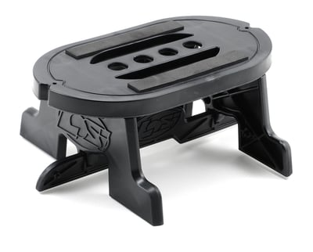

Slide 3
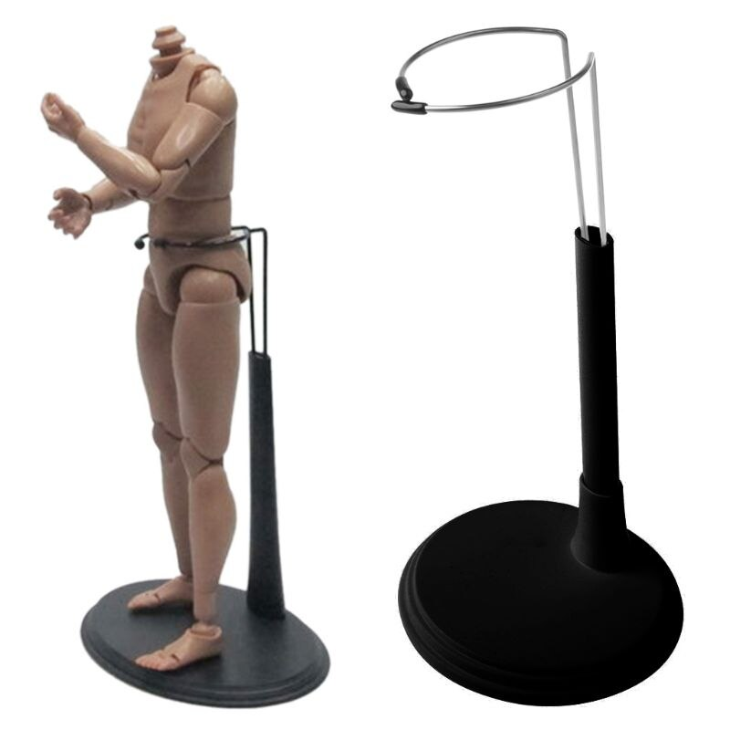
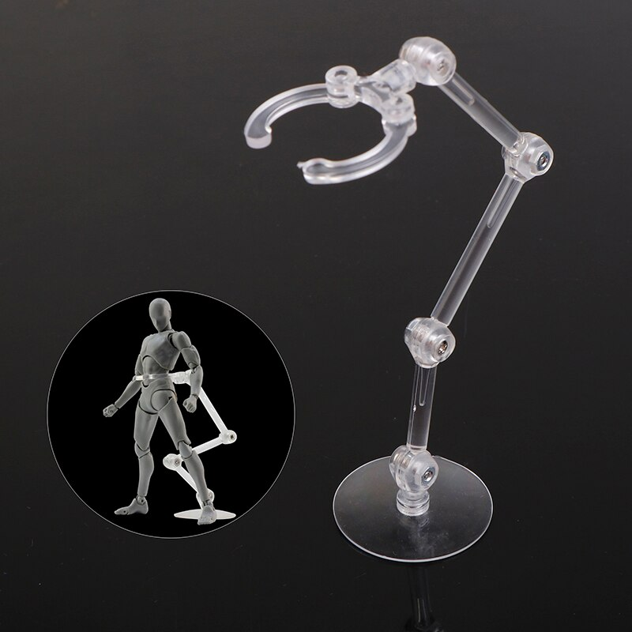

Slide 4
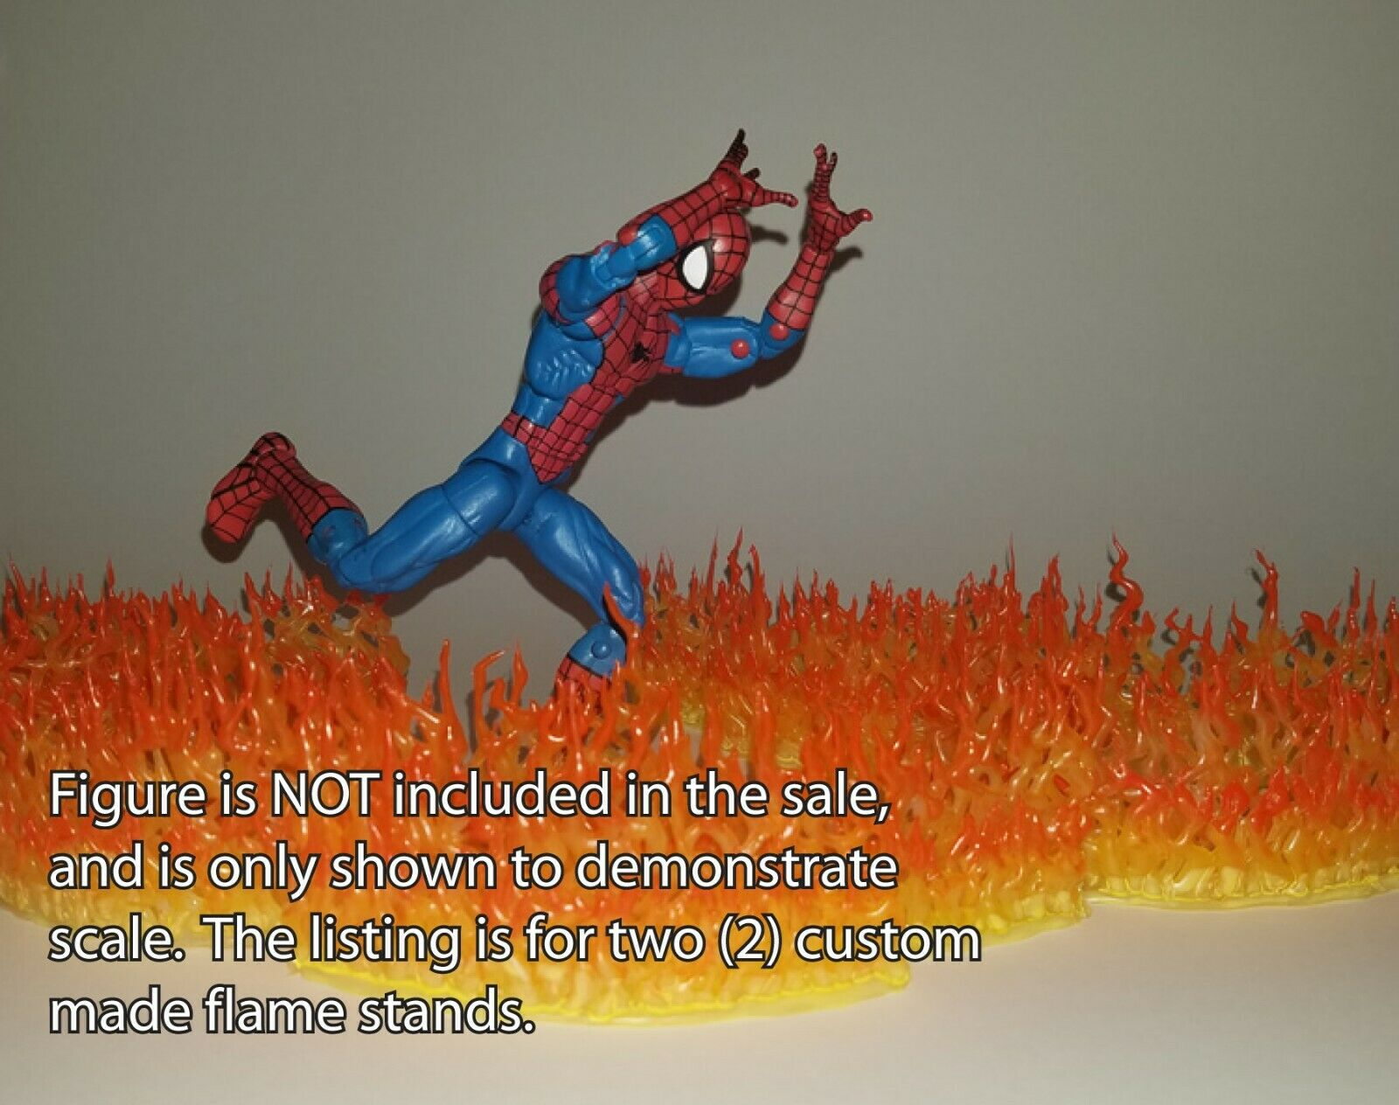
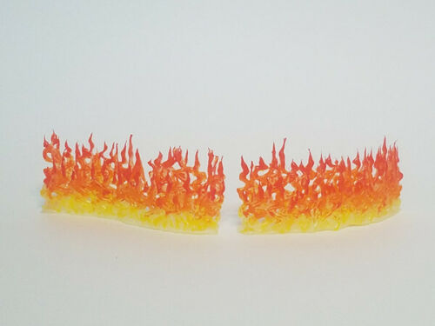

Slide 5
